Slide 1
Module 10
Http

Slide 2
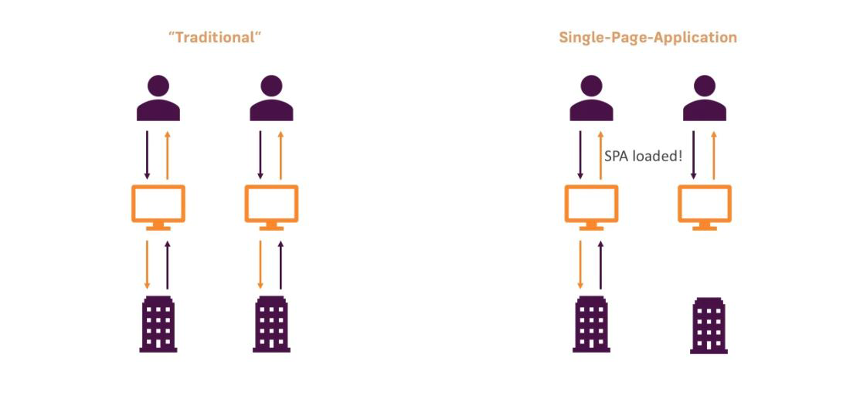
Traditional Web Apps vs SPAs

Slide 3
Http
Most front-end applications communicate with backend services over the HTTP protocol
The HttpClient in @angular/common/http offers a simplified client HTTP API for Angular applications that rests on the XMLHttpRequest interface exposed by browsers.
Additional benefits of HttpClient include testability features, typed request and response objects, request and response interception, Observable apis, and streamlined error handling.

Slide 4
Setup
import { HttpClientModule } from '@angular/common/http';
@NgModule({
imports: [HttpClientModule]
})
export class AppModule {}

Slide 5
import { HttpClient } from '@angular/common/http';
@Injectable()
export class RecipeService {
constructor(private http: HttpClient) { }
}
getRecipes() {
return this.http.get(‘assets/recipes.json’);
}

